Slide 1
OSCE Prep
Hematology

Slide 2
Hematology

Slide 3
Anemia
Macrocytic anemia's
Medications (eg, anti-convulsants, zidovudine, and immunosuppressive agents)
Vitamin B12 or folate deficiency or inborn errors of metabolism
liver disease
Aplastic anemia
Microcytic anemais
Iron deficiency anemia
Lead poisoning
Thalassemias
Sideroblastic anemia
Anemia of chronic illness

Slide 4
The previous all are associated with decreased RBC production
Normocytic anemia's
Decreased production Aplastic anemias
Hemorrhage (recent)
Sequestration
Infection
Renal disease

Slide 5
2. Anemias associated with increased RBC production characterized by reticulocytosis
Hemolytic anemias
intrinsic –hemoglobinopathy, membrinopathy, enzymopathy
extrinsic – immunologic , hemolytic disease of the newborn, toxins, microangiopathic hemolytic anemias

Slide 6
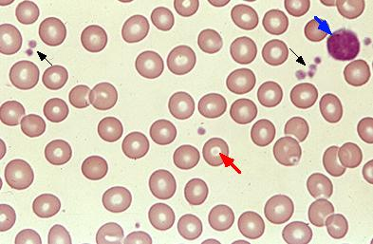
Normal RBC morphology

Slide 7
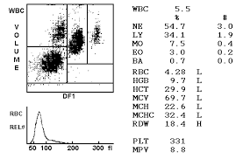
CBC feature

Slide 8
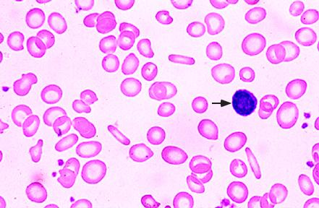
IDA
Microcytic hypochromic RBC
Tear drop cells
Pencil shaped
Target cells may be seen

Slide 9
DDX
α- or β-thalassemia
and other hemoglobinopathies, E and C
anemia of inflammation
Lead poisoning

Slide 10
Cause
Deficient intake
Growth
Blood loss
Impaired absorption
Inadequate presentation to erythroid precursors
Abnormal intracellular transport/utilization

Slide 11
Stages of Iron depletion
Iron depletion: may be detected by low serum ferritin
Iron-deficient erythropoiesis: serum iron level drops and the total iron binding capacity increases without a change in the hematocrit. Erythropoiesis begins to be limited by a lack of available iron and serum transferrin receptor levels increase.
Iron-deficiency anemia: is associated with erythrocyte microcytosis, hypochromia, increased RDW and elevated levels of FEP

Slide 12
manifestation
  GI
    anorexia
    pica
    atrophic glossitis
    guaiac positive stool
  CNS
    fatigue
    Irritability
    Poor development
    trombosis
  Cardiac
    increased cardiac output
    cardiac hypertrophy
  Musculoskeletal
    impaired exercise performance

Slide 13
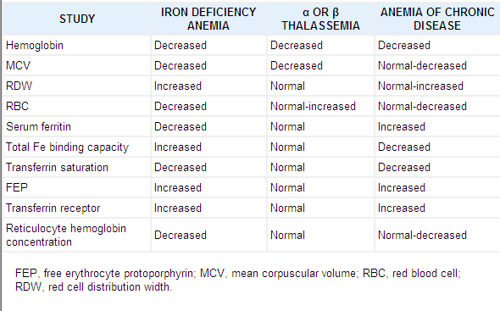
Labs of IDA
In IDA only RDW Total Iron Binding capacity, FEP and transferrin receptor are increased
Key feature is that Ferritin is low

Slide 14
Treatment
-Oral iron administration 4-6 mg/kg of elemental iron in 3 divided dose
for 1-3mo in order to replenish the store
-Dietary education of the parents
-Parentral iron limited role
-Blood transfusion is indicated when the
anemia is severe Hgb< 4g/dl, presence of
failure

Slide 15
Time after administration Response
12-24hrs----------------- intracellular enzyme replaced (subjective improvement: good appetite, decrease irritability)
36-48hrs------------------initial BM response; erythroid hyperplasia
48-72hrs------------------Reticulocytosis
4-30days------------------increase in Hb
1-3months----------------Store replacement

Slide 16
Thalassmia
Inherited
Major and Minor
Major seen after 3-6 months
C/f
Anemia at 6 months
Jaundice
Frontal Bossing
Splenomegally
##Target cells are characteristic
Tx- periodic blood transfusion , splenectomy and folic supplementation
Sideroblastic
Cerebellar sxs- like lack of coordination, ataxia
DTR
Incoordination
#CXCS- Increased serum iron and ferritin with dcreased TIBC
Opposite of IDA
Peripheral smear shows papenhemier bodies in RBC
Ringed sideroblast is hallmark
Tx- Vitamin B6(pyridoxine)

Slide 17
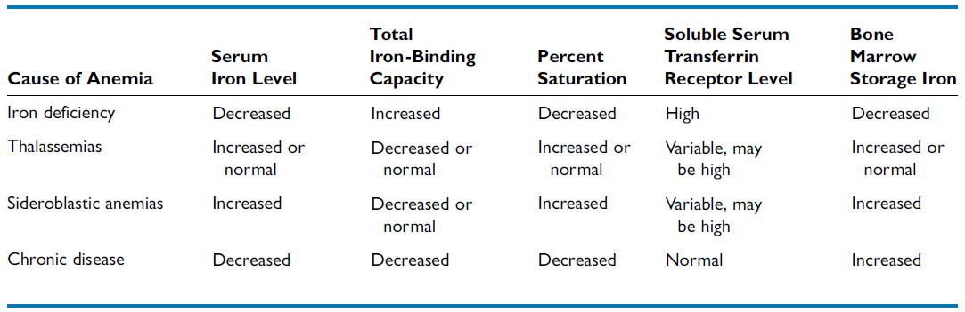
Important

Slide 19
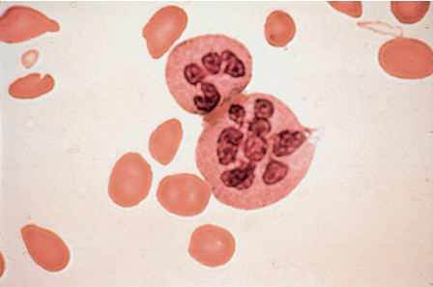
Megaloblastic Anemia
The peripheral blood smear is notable for large, often oval, RBCs, with increased mean corpuscular volume (MCV).
Neutrophils are characteristically hypersegmented, with many having >5 lobes

Slide 20
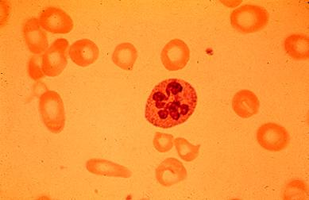

Slide 21
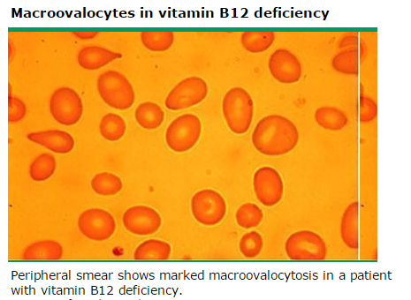
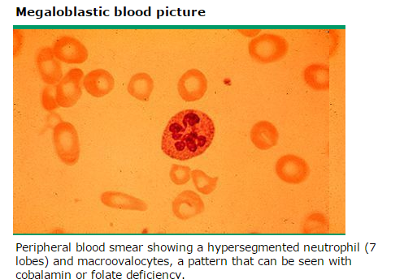

Slide 22
Folate
  Is abundant in many foods
  Biologically active form is THF
  absorbed throughout the small intestine
  anemia occurs after 2-3 months of folate free diet
Etiology
  Inadequate folate intake
  Decreased folate absorption
  Congenital abnormalities in folate metabolism
  Drug induced abnormalities in folate metabolism
MX- Folic acid 0.5-1 mg/day for 3-4 wks till definite hematologic response

Slide 23
Vit. B12
Etiology
  Inadequate intake
  Lack of intrinsic factor
  Impaired absorption
Absence of transport proteinweakness, fatigue, FTT or irritability
Other findings include pallor, glossitis, vomiting, diarrhea and icterus
Neurologic manifestations include parasthesias, sensory deficit, hypotonia, seizure, developmental delay, developmental regression and neuropsychiatric changes

Slide 24
Mx of vit B12
Prompt hematologic response follows parenthral administration of vit. B12 (1mg) usually with reticulocytosis in 2-4 days
Neurologic manifestation 1 mg should be injected daily for 2 weeks
Monthly administration of 1 mg of vit. B12 IM is sufficient as maintenance

Slide 25
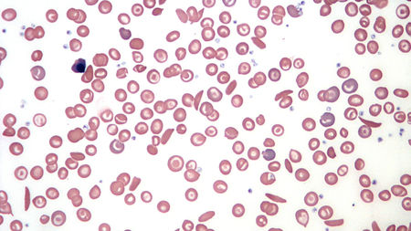
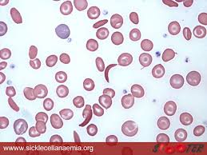
Sickle cell anemia

Slide 26
Cxcs of sickle cell
Low hemoglobin and hct
High reticulocyte count
High WBC, PLT and serum bilirubin
Present as a sudden severe anemia and serve pain, fever – vasoocclusive crisis
Peripheral Smear- Howel Jolly bodies and sickle shaped RBC
Tx- BM transplant, hydroxiuria and in the case of hemolytic crisis- IV fluid, oxygen,Blood transfusion

Slide 27
Hemolytic Anemia
  RBC survival is shortened
  the RBC count falls
  erythropoietin is increased
  and the stimulation of marrow activity results in heightened RBC production

Slide 28
Causes of hemolytic anemia
INTRACORPUSCULAR HEMOLYSIS
  Membrane Abnormalities
  Metabolic Abnormalities
  Hemoglobinopathies
EXTRACORPUSCULAR HEMOLYSIS
  Nonimmune
    Idipathic
    Secondary
  Immune
    Isoimmune
    Autoimmune
      Idiopathic
      Secondary : infection , drugs , hematologic , immunopathic , tumors

Slide 29
Laboratory Features
Direcet coombs test is postive
  Peripheral blood smear microscopy:
    fragments of the red blood cells ("schistocytes") can be present
    some red blood cells may appear smaller and rounder than usual (spherocytes)
  Reticulocytes are present in elevated numbers.
  Bone marrow smear microscopy: erythroid hyperplasia (megaloblasts)
  The level of unconjugated bilirubin in the blood is elevated.
  The level of lactate dehydrogenase (LDH) in the blood is elevated

Slide 30
Hemolytic anemia tx
Treatment
  Blood transfusion
  Splenectomy
  Treat the cause
  Immunosuppresive

Slide 31
Bleeding Disorder

Slide 32
Bleeding
disorders
Vascular
abnormalities
***
Platelet disorders
Clotting factor
abnormalities
DIC

Slide 33
ITP
classic presentation of ITP is that of a previously healthy 1–4 yr old child who has sudden onset of generalized petechiae and purpura.
The parents often state that the child was fine yesterday and now is covered with bruises and purple dots. Often there is bleeding from the gums and mucous membranes, particularly with profound thrombocytopenia (platelet count <10 × 10⁹/L). There is a history of a preceding viral infection 1–4 wk before the onset of thrombocytopenia.
Findings on physical examination are normal, other than the finding of petechiae and purpura. Splenomegaly is rare, as is lymphadenopathy or pallor.

Slide 34
CXCS of severity
No symptoms
2. Mild symptoms: bruising and petechiae, occasional minor epistaxis, very little interference with daily living
3. Moderate: more severe skin and mucosal lesions, more troublesome epistaxis and menorrhagia
4. Severe: bleeding episodes—menorrhagia, epistaxis, melena—requiring transfusion or hospitalization, symptoms interfering seriously with the quality of life

Slide 35
Additional ix
ANA
Prolonged BT but normal PT and PTT
HIV
CBC with differential
BM examination
Coombs
Peripheral smear shows thromboctopenia and giant PLTS
BM- megakaryocytes

Slide 36
Management of ITP
If mild to moderate sxs- no therapy other than education and counseling
IV IG -to induce a response by down regulating Fc-mediated phagocytosis of antibody-coated platelets
IV anti D for RH positive
Prednisone for acute and chronic ITP in adults
Chronic ITP- (>6months of thrombocytopenia)
Evaluate for other autoimmune conditions
-Do splenectomy after giving pneumococcal vaccine
Feared complication- intracranial bleed

Slide 37
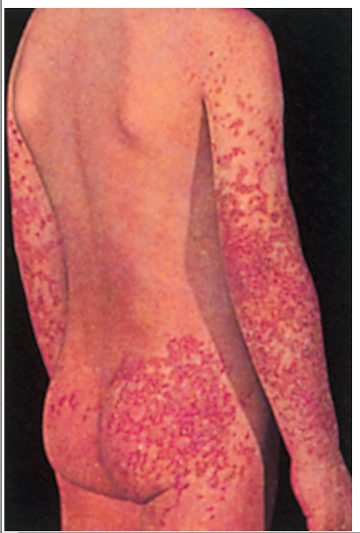
HSP
Male patient that presents with a The hallmark of the disease is the rash, beginning as pinkish maculopapules that initially blanch on pressure and progress to petechiae or purpura, which are characterized clinically as palpable purpura that evolve from red to purple to rusty brown before they eventually fade .
Arthritis, present in more than ⅔ of children with HSP, is usually localized to the knees and ankles and appears to be concomitant with edema.
Colicky abdominal pain
Hematuria, proteinuria
50% also have a preceeding URTI in the past 3 weeks

Slide 38
Rash
Edema
Arthiritis with abdominal pain and renal findings
IX-
Esr- increased
Thrombocytosis, leukocytosis
Anemia
ANA
APL
Urine analysis with WBC, RBC casts, albumin
Renal biopsy showing mesangial deposits

Slide 39
Complications and MX
Renal involvement - Nephrotic syndrome
Bowel perforation
Scrotal edema, testicular torsion
MX
Symptomatic treatment

Slide 40
DIC
Acute DIC- bleeding from venipuncture or surgical sites
Petechiae and echymoses, necrosis
Minial to profound shock, renal failure, dyspnea, convulsion and coma
Low- PT,PTT, Platlet, fibrinogen
Elevate plasma fibrin
Fragmented burr and helmet shaped RBC- schistocytes

Slide 41
Hemophilia A and B
Factor 8 deficiency - Hem.A
Factor 9 deficiency- Hem.B
Males more commonly affected
Both factors don’t cross the placents so symptoms may be present from birth and may occur in the fetus

Slide 42
easy bruising, intramuscular hematomas, and hemarthroses
Bleeding from minor traumatic lacerations of the mouth (a torn frenulum) may persist for h
The hallmark of hemophilia is hemarthrosis eg. Ankle join hemorrhage

Slide 43
Hemophilia labs
PTT-decreased in factor 8
CT and PTT in factor 9
Platlet, bleeding time and prothrombin time are all normal
Dx- decreased factor level with normal von willebrand factor antigen

Slide 44
Tx of hemophilia
Early, appropriate therapy is the hallmark of excellent hemophilia care.
Prevention of trauma
Avoid aspirine
immunization
With mild factor VIII hemophilia, the patient's endogenously produced factor VIII can be released by the administration of desmopressin acetate

Slide 45
Hemorrhagic disease of the newborn
1.Vitamin K
Spontaneous hemorrhage in a new born
Bleeding time, fibrinogen, factors V and VIII, platelets, capillary fragility, and clot retraction are normal for maturity

Slide 46
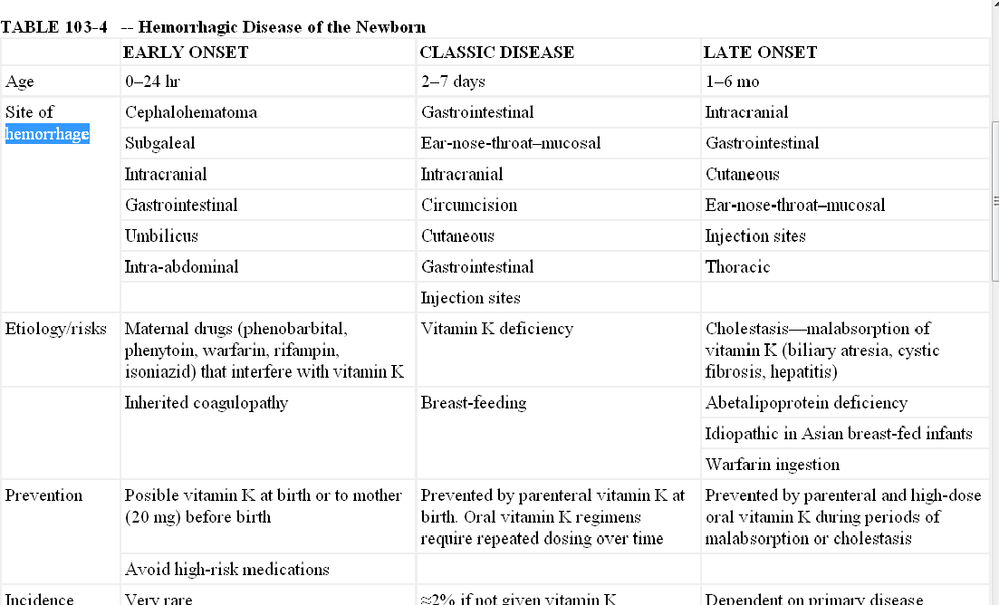

Slide 47
PT,PTT & CT are prolonged
Level of factor II,VII,IX AND X are prolonged.
BT, factor I,V and platelets are normal.
Diagnosis is confirmed by demonstration of PIVKA and improvement with vitamin k treatment.
MX-
IM 1mg vitamin K- prophylactic
Treatment – slow IV infusion of vit.K

Slide 48
Newborn DIC
Affected infants are often premature; the clinical course is frequently characterized by asphyxia, hypoxia, acidosis, shock, hemangiomas, or infection.
Results secondary to an insult eg. maternal toxemia, GBS infection, Abruptio placenta, Severe RDS, Necrotizing enterocolitis, congenital viral disease(CMV and HSV), Fetal demise and Erythroblastosis fetalis

Slide 49
MX of newborn DIC and investigations
Ix- low platlet, increased factor 1 and FDP
MX- treat the cause

Slide 50
Other HDN d/o
Swallowed blood syndrome
Blood or bloody stool usu passed on the 2nd or 3rd day
Differentiation from gastrointestinal hemorrhage is based on the fact that the infant's blood contains mostly fetal hemoglobin, which is alkali-resistant,
whereas swallowed blood from a maternal source contains adult hemoglobin, which is promptly changed to alkaline hematin after the addition of alkali. Apt test is used for this differentiation:

Slide 51
